Slide 1
Ration Formulation for Ruminant
Pelatihan Uji Mutu dan Formulasi Pakan Era 4.0
Dr.Ir. Idat Galih Permana, MScAgr.
Bogor Agricultural University
email: permana@apps.ipb.ac.id

Slide 2
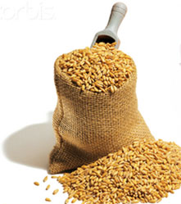
What is a Ration ?
A RATION is the amount of feed an animal receives in a 24-hour period.
A BALANCED RATION is the amount of feed that will supply the proper amount and proportions of nutrients needed for an animal to perform a specific purpose such as growth, maintenance, gestation, lactation or laying.

Slide 3
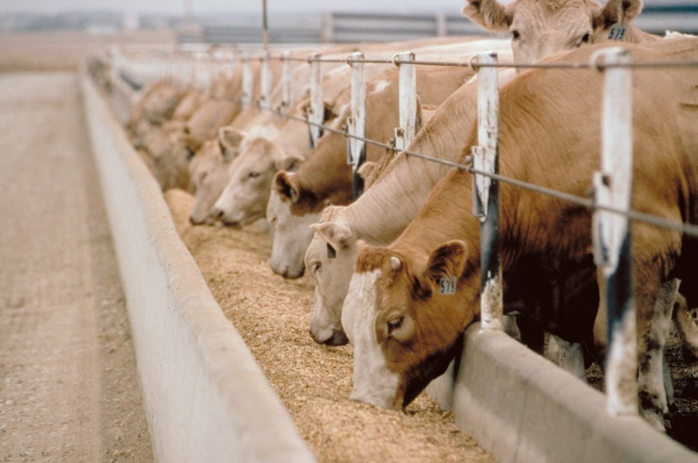
Beef Cattle Ration
Calf (milk replacer, calf starter)
Growing (grower ration)
Fattening (finisher ration)

Slide 4
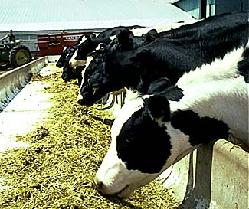
Dairy Cattle Ration
Calf (milk replacer, calf starter)
Growing (grower)
Heifer (heifer ration)
Lactation (lactation ration)
Dry (dry cows ration)

Slide 5
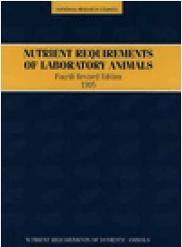
Nutrient Requirements
Nutrient requirements are the amount of nutrients the animal needs for a specific purpose.
They are influenced by many factors, such as weight of animal, sex, desired rate of growth, stage of lactation, environment and others.
Nutrient requirements may be found in published tables, such as published by the National Research Council (NRC).

Slide 6
Nutrient Requirements
Maintenance (nutrient for basic activities (breath, blood flow, low activities) without body weight change
Production (meat, milk, reproduction, etc.)

Slide 7
Nutrient Requirement of Ruminants
Energy
Protein
Mineral
Vitamin
Water

Slide 8
Energy
Energy is the most limiting nutrient to ruminant.
Sources of energy:
grass, cereal grains such as corn, oats, wheat and barley and bypass fats.
Energy limitations caused by:
Inadequate feed intake, too much low quality feed, incorrect roughage to concentrate ratios.
Insufficient energy cause:
weight loss, infertility and reduced production

Slide 9
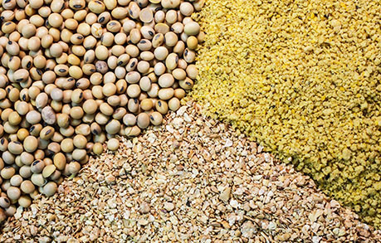
Protein
Protein is made up of amino acids. Amino acids are vital to all body processes.
Source of protein are:
Legume, soybean meal, palm kernel meal, coconut meal, corn gluten meal, tofu waste, etc.

Slide 10
Mineral
Minerals are essential to body functions of an animal. Macro minerals are the minerals most nutritionists balance for in a ration because they are usually deficient without supplementation.
Macro Minerals:
Calcium (Ca), Phosphorus (P), Magnesium (Mg), Sodium (Na) and Chloride (Cl).
Micro Minerals:
Copper (Cu), zinc (Zn), cobalt (Co), iodine (I), selenium (Se), iron (Fe) and manganese (Mn).

Slide 11
Vitamins
Vitamins can be divided into two major groups:
Fat Soluble Vitamins and Water Soluble Vitamins.
The fat soluble vitamins are stored in the fat or lipid portion of feed and include vitamins A, D, E and K.
The water soluble vitamins (Vit B) are usually met by feedstuffs, rumen synthesis and tissue synthesis.

Slide 12
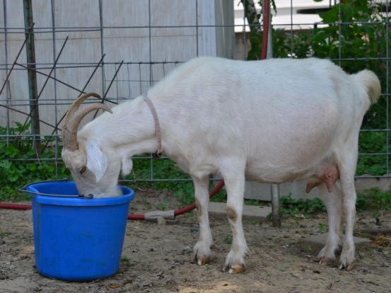
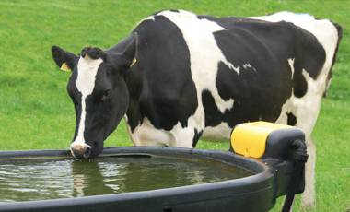
Water
Water is the important nutrient. Access to clean water is very important in dairy goat production
The function of water:
digestion, nutrient absorption, excretion of waste products, control of body temperature, growth of young animals and milk production.
Water requirement depend on:
Physiological status
Environment temperature
Kind of feed
Water requirement should ad libitum

Slide 13
Nutrient Requirement for Ruminants
Maintenance Requirement:
Basic living requirement for basic activities (breathing, blood circulation, maintaining body temperature) with no change in body weight
Production Requirement:
Growth
Reproduction
Pregnancy
Milk Production
Milk Quality

Slide 14
Type of Feed Ingredient for Ruminants
Roughage
Concentrate
Feed Supplement
Additive

Slide 15
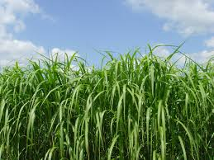
1. Roughage
In ruminant, the roughage is as energy source
Kind of roughage
Grass (native grass, napier grass, king grass, benggala grass, etc)
Legume (leucaena, gliricidia, caliandra, sesbania, indigofera, etc)
Agricultural Wastes (rice straw, corn stover, sweet potato leaf, cassava leaf, etc)

Slide 16
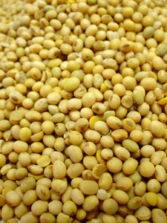
2. Concentrate
Concentrate as energy or/and protein sources
The quality of concentrate depend on:
Processing
Palatability
Nutrient composition
Contamination
Storage

Slide 17
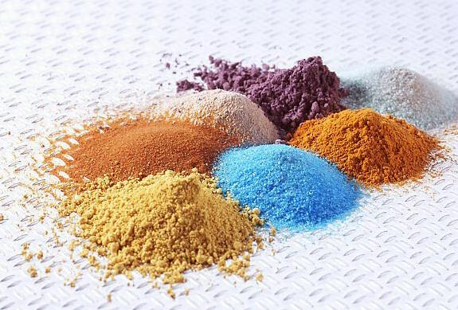
3. Feed Supplement
A feed used with another to improve the nutritive balance or performance
Supplement is needed a small amount to enrich
A source of micro-nutrients (minerals and vitamins)
Usually given in the form of Premix

Slide 18
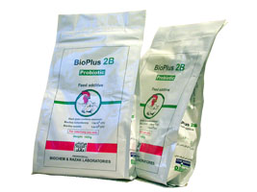
4. Additive
An ingredient or combination of ingredients added to the basic feed mix or parts thereof to fulfil a specific need.
Usually used in micro quantities and requires careful handling and mixing
Additive is not a natural feed (probiotics, prebiotic, enzymes, anti-fungal, etc.)

Slide 19
Feed Ingredients

Slide 20
Corn
Corn as energy source
Water content of 12-14 %
Nutrient content:
Crude Protein 7-8%
Low Crude Fiber
TDN 80-82%
The quality of local corn varies depend on post-harvest handling and storage

Slide 21
Rice Bran
Rice bran is rice mill waste
As energy source for ruminant
Water content of 10-14%
The quality varies
Water 10-14%
Crude Protein 10-12%
TDN 65%
Used in ruminant 40% and in poultry 10-20%
Problems:
High CF, easy to rancidity, high phytate acid and often mixed husks or limestone

Slide 22
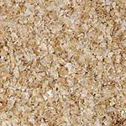
Wheat Pollard
Pollard is byproduct of milling wheat
Used as energy source for ruminant
The quality of pollard is relative stable:
Water content 10-12 %
Crude Protein 14%
TDN 68%
Constraints Crude Fiber 13 %

Slide 23
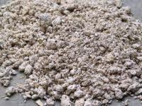
Cassava Waste
Cassava waste is byproduct from tapioca industry
Used as energy sources
Nutrition content:
Low Crude Protein 1.8-2%
High energy TDN 78.9%
Contains HCN (but lower than cassava)
In ruminant rations used up to 40%

Slide 24
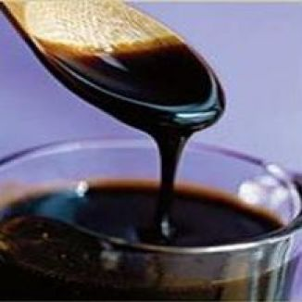
Molasses
Molasses is a byproduct from sugar mill
Has high palatability, both for ruminants and poultry.
High carbohydrate content (48-60% in the form of sugar).
Have a good mineral content.
An important ingredient for the manufacture of mineral blocks.
Its use in ruminant ration 15%

Slide 25
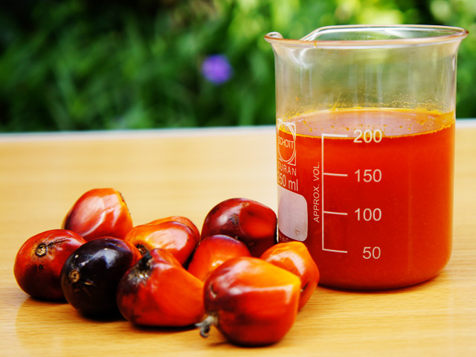
Crude Palm Oil (CPO)
CPO is main products of palm oil industry
As energy sources
Nutrient content:
Water content of 1-2 %
EM 7800-8000 kcal/kg
In Poultry used up to 5 %
Improving the palatability of the ration
Low heat increment

Slide 26
Soybean Meal (SBM)
SBM is a byproduct from processing soybean oil
As protein sources, has complete amino acids
Nutrient content:
Water content of 10-11%
Crude protein 49-52%
TDN 90%
Limitation: trypsin inhibitor

Slide 27
Palm Kernel Meal (PKM)
PKM or PKC is byproduct from palm oil industry
The composition of nutrients vary depending on the processing
Crude Protein 13-17%
TDN 68-70%
Fat and fiber varies
Methionine deficiency
Used in ruminant max 25%

Slide 28
Corn Gluten Meal (CGM)
CGM is a waste oil processing corn
Used as protein sources
Nutrient contents:
Water content 9-10%
Crude Protein 65%
ME 3900-4000 kcal/kg
Usage on poultry feed up to 8%
CGM Import USA

Slide 29
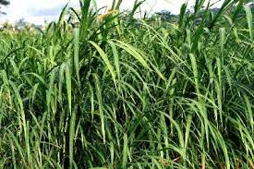
Elephant Grass - Napier Grass
Origin from Africa middle area
Productivity is high (150 ton/ha/year)
Nutrient content:
DM 12-18%
CP 6-9%
CF 26-40%
TDN 55-67%
Palatability is quite good

Slide 30
Leucana leucocephala
Origin from Guatemala.
Nutrient content:
CP : 14-19%.
CF : 33-66%.
Vit content C and A are usually high.
Contains anti nutrition mimosin, dangerous especially for monogastrik.
Used up to 25% in goat ration

Slide 31
Caliandra calothyrsus
Origin from Central America
Nutrient content:
Crude Protein quite high 24%.
Crude Fiber relatively low 24%
Generally does not contain toxins.
The content of tannin is quite high 11%.
This tannin causes low digestibility

Slide 32
Sebania sesban
Origin from Southeast Asia.
Palatability is very good.
Nutrient content:
Crude Protein is quite high around 29%.
Crude Fiber is quite low 5-18%.
Containing saponins and tannins
Digestibility is quite high 65-73%.

Slide 33
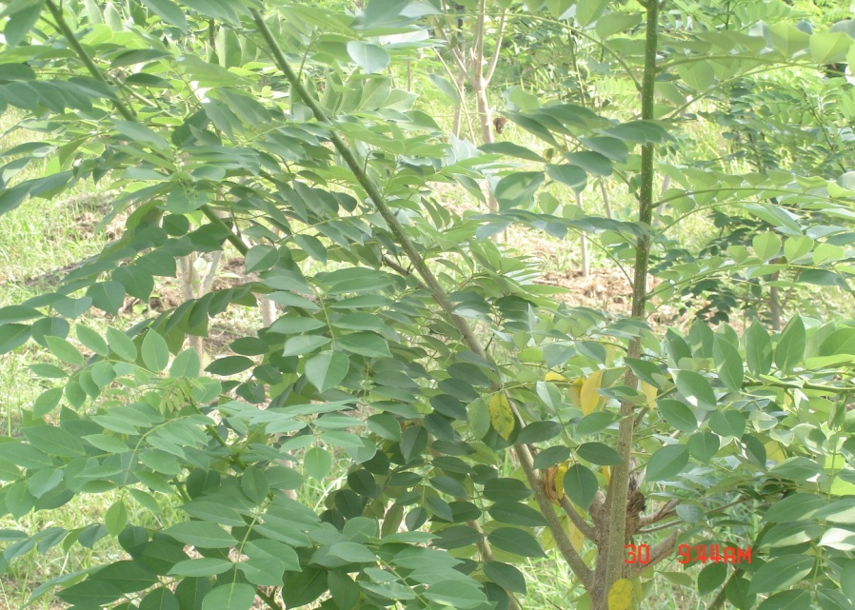
Gliciridia sepium ( Jacq.)
The origin from Central America.
Nutritional quality varies:
Crude Protein is about 19%
Palatabily relatively low
Contains Flavanoid anti nutrition 1-3.5% and 3-5% phenol IN dry matter.
Digestibility is from 55-70%

Slide 34
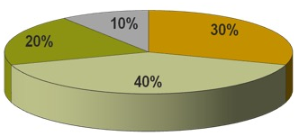
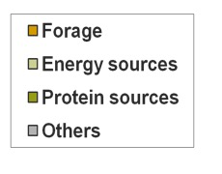
Ration of Beef Cattle
In feedlots the use of concentrate is higher than forage
Concentrate ingredients: rice bran, onggok, coconut meal, palm oil meal, tofu waste, molasses, etc.

Slide 35
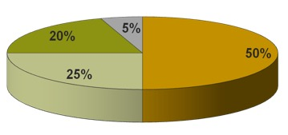
Ration of Dairy Cattle
Forage as main source fo energy
Concentrate ingredients: rice bran, onggok, coconut meal, palm oil meal, tofu waste, molasses, etc.

Slide 36
Standar Nasional Indonesia SNI Pakan Konsentrat Sapi Potong SNI Pakan Konsentrat Sapi Perah

Slide 37
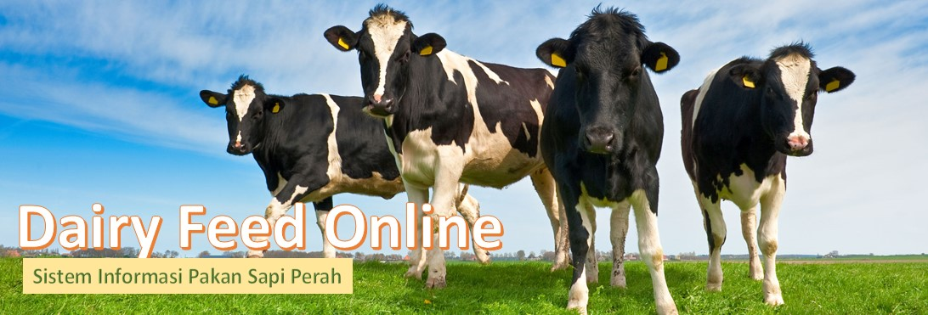
Ruminant Ration Formulation using Dairy Feed Online
Dr. Idat Galih Permana
Bogor Agricultural University
email: permana@apps.ipb.ac.id

Slide 38
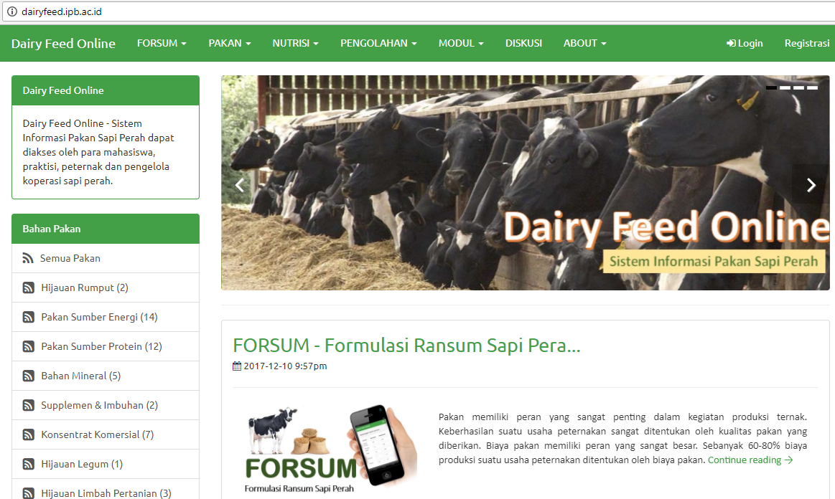
Dairy Feed Online http//dairyfeed.ipb.ac.id

Slide 39
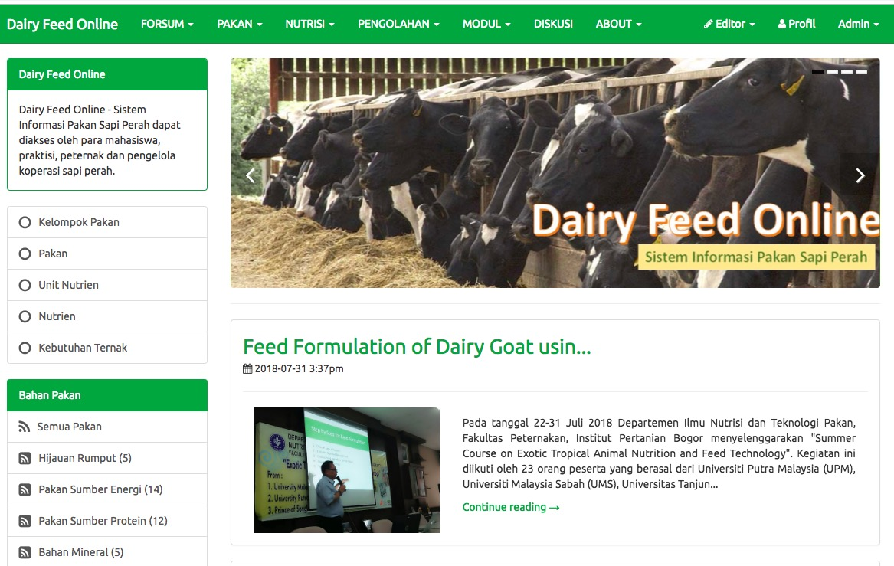
Dairy Feed Online http//dairyfeed.ipb.ac.id
Forsum
Kecukupan Nutrien
Formulasi Ransum
Ransum Sapi Perah
Simulasi Linear Programming
Q &A
Tentang Forsum
Pakan
Nutrien
Pengolahan
Modul
Diskusi
About

Slide 40
What is FORSUM Online ?
FORSUM Online is an web based application for ration formulation for dairy cattle of ruminant using local feed ingredients
FORSUM calculate the ration using Linear Programing
Least cost ration

Slide 41
Linear Programming
Linear Programming (LP) is a technique for optimization of a linear objective function, subject to linear equality and linear inequality constraints. Informally LP determines the way to achieve the best outcome (such as maximum profit or lowest cost)
Developed by George B. Dantzing, published the simplex method in 1947

Slide 42
Mathematic Model of LP
Minimize c₁x₁ + c₂x₂ + c₃x₃ + ... + c_{j}x_{j}
Constraints
a₁₁x₁ + a₂₁x₂ + a₃₁x₃ + ... + a_{ij}x_{j} > b₁
a₁₂x₁ + a₂₂x₂ + a₃₂x₃ + ... + a_{ij}x_{j} > b₂
......
a_{i2}x₁ + a_{i2}x₂ + a_{i2}x₃ + ... + a_{ij}x_{j} > b_{i}
x₁ + x₂ + x₃ + ... + x_{j} = 1
Assume:
x₁, x₂, x₃, ... , x_{j} > 0
c_{j} = ingredient prices
x_{j} = use of ingredients
a_{ij} = nurient contents
b_{i} = nutrient requirements

Slide 43
Mathematic Equation for Ration Formulation
Minimize Cost :
3000 Corn + 1500 RB + 4500 CGM + 6000 FM + 4500 CPO + 200 CC + 8000 DCP
Subject to:
8 Corn + 11.32 RB + 64 CGM + 55 FM > 21 (Protein)
3300 Corn + 3100 RB + 3500 CGM + 2853 FM + 7500 CPO > 3100 (EM)
0.02 Corn + 0.07 RB + 0.05 CGM + 7.19 FM + 40 CC + 22.7 DCP > 0.9 (Ca)
0.28 Corn + 1.50 RB + 0.50 CGM + 2.88 FM + 17.68 DCP > 0.45 (P)
Corn + RB + CGM + FM + CPO + CC + DCP = 1 (Total 100%)
Assumption:
Corn, RB, CGM, FM, CPO, CC, DCP > 0

Slide 44
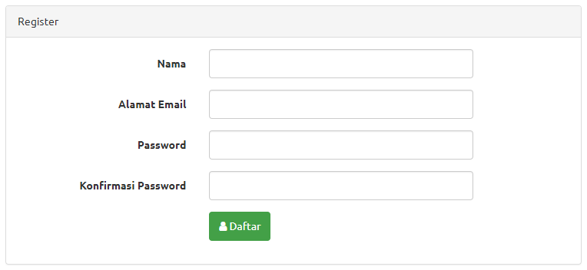
How is to registration ?
Click Registration
Entry user name
Entry email address
Entry Password
Re-entry Password

Slide 45
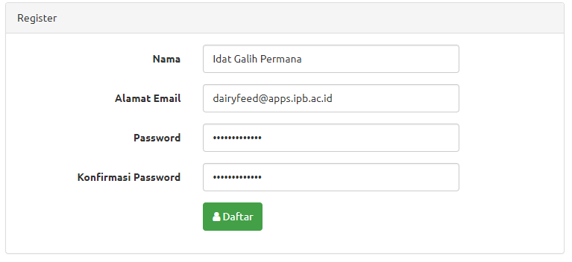
How is to registration ?
Example registration form:

Slide 46
Nutrient Requirement of Lactation Cows

Slide 47
Nutrient Requirement of Lactation Cows

Slide 48
Nutrient Requirement of Lactation Cows

Slide 49
Step by Step for Feed Formulation
Choose Type of Rations
Entry the Nutrient Requirement
Choose Feed Ingredient for the Ration
Calculate the Formula
The Result

Slide 50
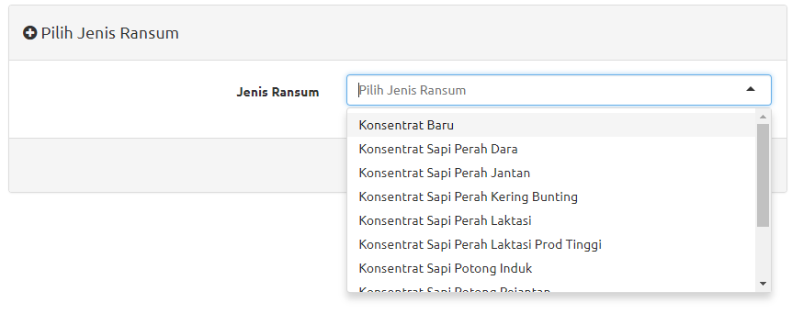
1. Type of Rations
Choose Menu FORSUM and Sub Menu FORMULASI RANSUM
Choose type of Ration:
Concentrate of dairy cattle (Konsentrat Sapi Laktasi)
Concentrate of heifer (Konsentrat Sapi Dara)
Concentrate of Bull (Konsentrat Sapi Jantan)
Etc

Slide 51
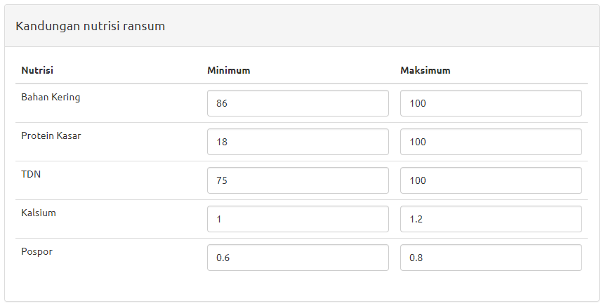
2. Entry the Nutrient Requirement
Entry the nutrient requirement/restriction of MINIMUM and MAXIMUM for each nutrient or use nutrient standard.

Slide 52
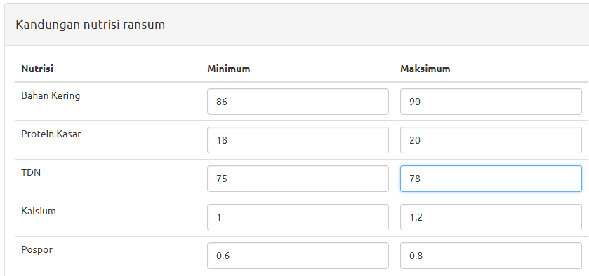
Nutrient restrictions

Slide 53
3. Choose Feed Ingredient for the Ration
Click “Pilih Bahan Pakan” (Choose Ingredients), then choose:
Native grass (Rumput Lapang)
Naper grass (Rumput Gajah)
Corn (Jagung), …. etc
Click “Tambah Pakan” (Add Ingedient), for Add other feed ingredients
Click ”Hapus” (Delete) for delete a feed ingredient
Delete Feed Ingredient
Choose Feed Ingredient

Slide 54
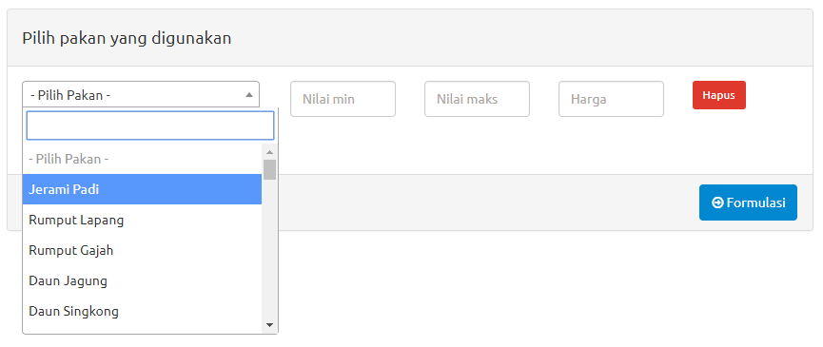
Choose Feed Ingredients
Choose Feed Ingredient

Slide 55
Example: List of Feed Ingredients
Bahan Pakan | Min | Max | Harga (Rp/kg)
Jagung | 10 | 40 | 3,000
Bungkil Kedelai | - | 30 | 6,500
Bungkil Kelapa | - | 30 | 2.750
Bungkil Sawit | - | 20 | 1,400
Dedak Padi Halus | - | 30 | 1,800
Onggok | - | 30 | 2,200
Kapur | - | 2 | 500
Dicalsium Phospat | - | 1.5 | 20,000

Slide 56
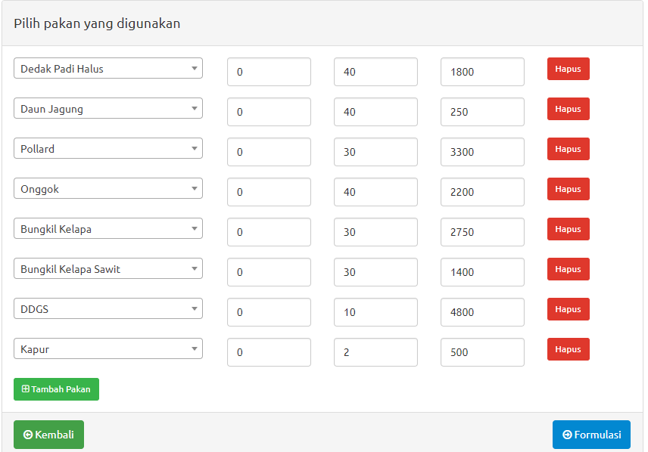
4. Calculate the Formula
When all the feed ingredients are choose, than click “FORMULASI” (Formulation) to calculate.
FORMULATION

Slide 57
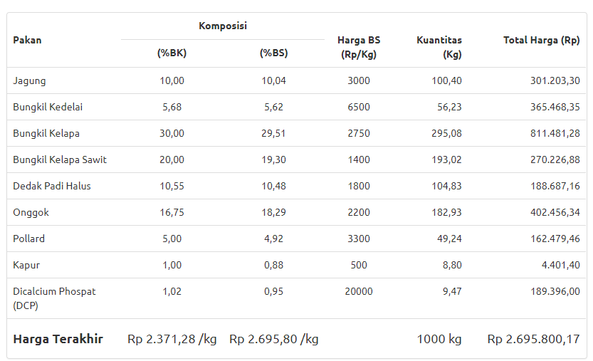
5. Result of Ration
Ration Composition

Slide 58
Ration Composition
In Dry Matter Composition
In As Feed Composition

Slide 59
Ration Composition
Price per kg DM
Price per kg As Feed
Kg ration totsl
Ration Cost

Slide 60
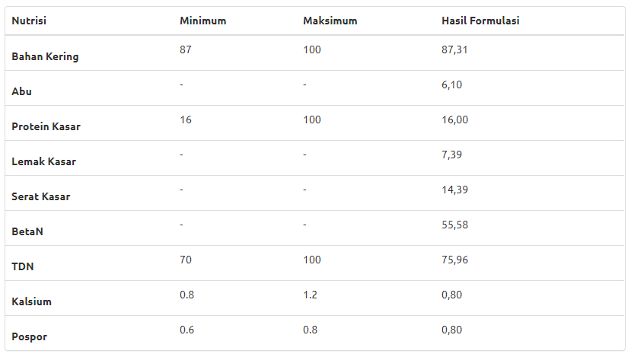
Nutrient Composition of the Ration
In Dry Matter (DM) Composition

Slide 61
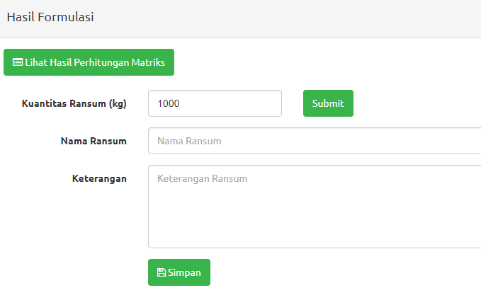
6. Save the File
Click SIMPAN to save the file of ration
Entry the quantity of ration (kg), Name of Ration and Notes
Then Click SUBMIT
Quantity of Ration
Quantity, Name of Ration and NotesRansum
Save File

Slide 62
Thank you
Dairy Feed Online – http://dairyfeed.ipb.ac.id
Dairy Expert:
Dr. Ir. Idat Galih Permana, MSc.Agr.
Email: permana@apps.ipb.ac.id
HP. 081 380 263 993

